Slide 1
6LoWPAN
( IPv6 over LoWPAN)
Date: 27.04.2022

Slide 2
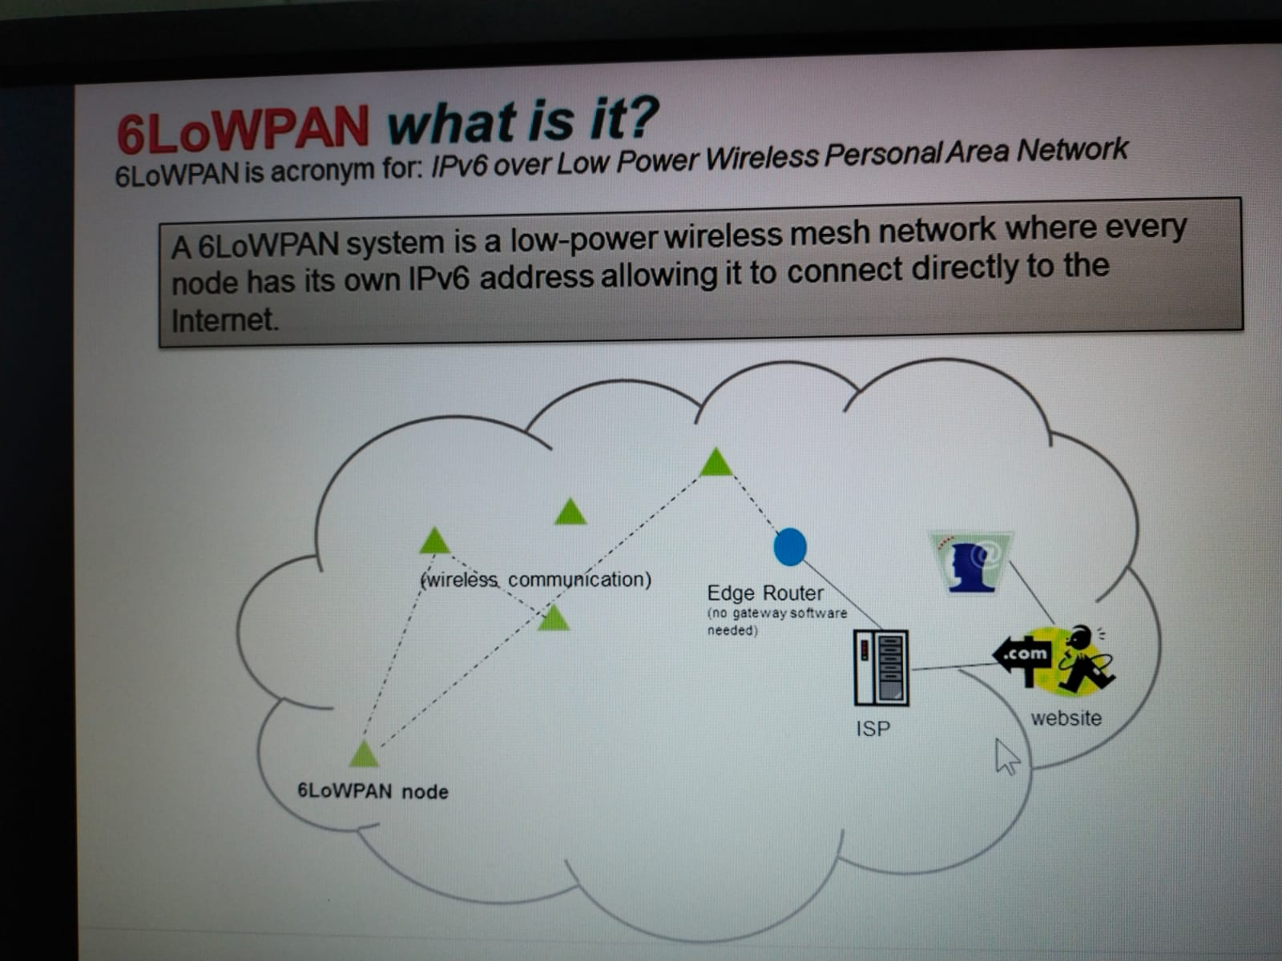
VCE

Slide 3
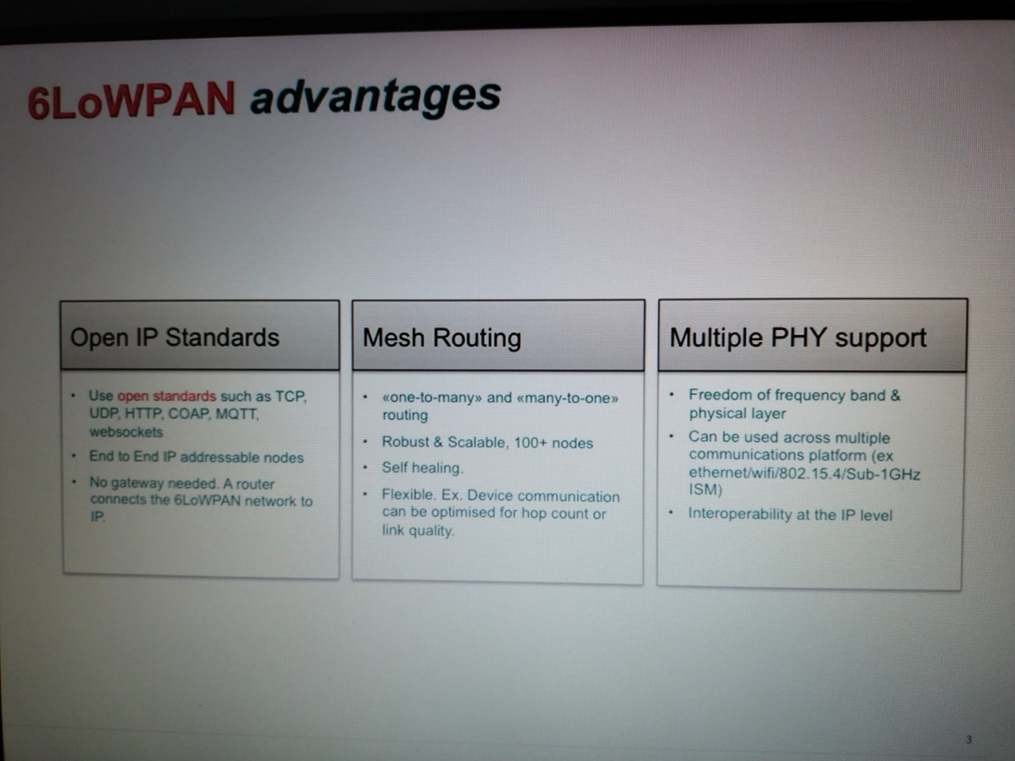
VCE

Slide 4
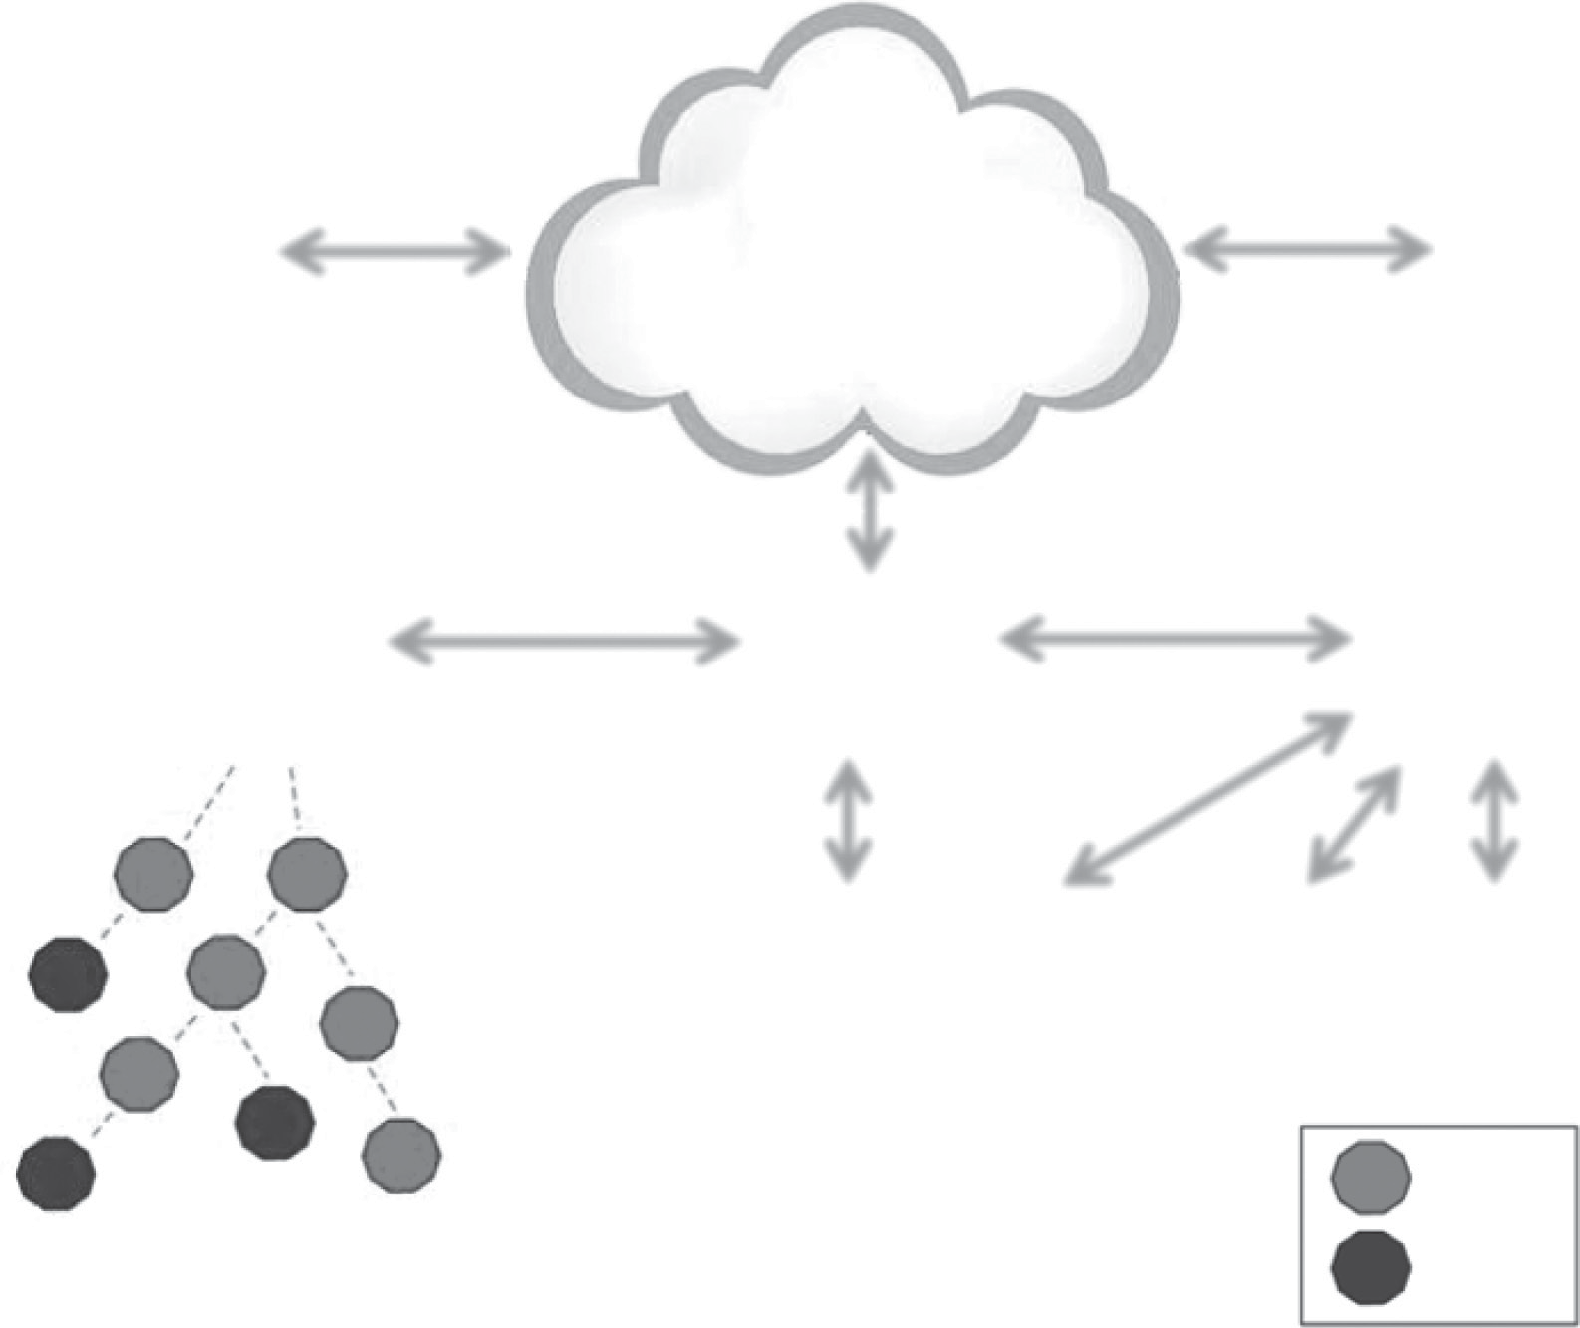
Network architecture of 6LoWPAN
INTERNET
Server
Server
2001:1234::1234
2001:4321::4567
6LoWPAN
edge router
Router
Router
2001:8765:23::/48
2001:8765::/48
2001:8765:22::/51
R ::1
R
R
::3
P P
C C
2001:8765:22::
2001:8765:22::3
P
C
P
C
H
::2
::4
R
::8
2001:8765::5481 2001:8765:22::1
R
::5
H
H
::7
R ::9
::6
R = Router
H = Host
VCE

Slide 5
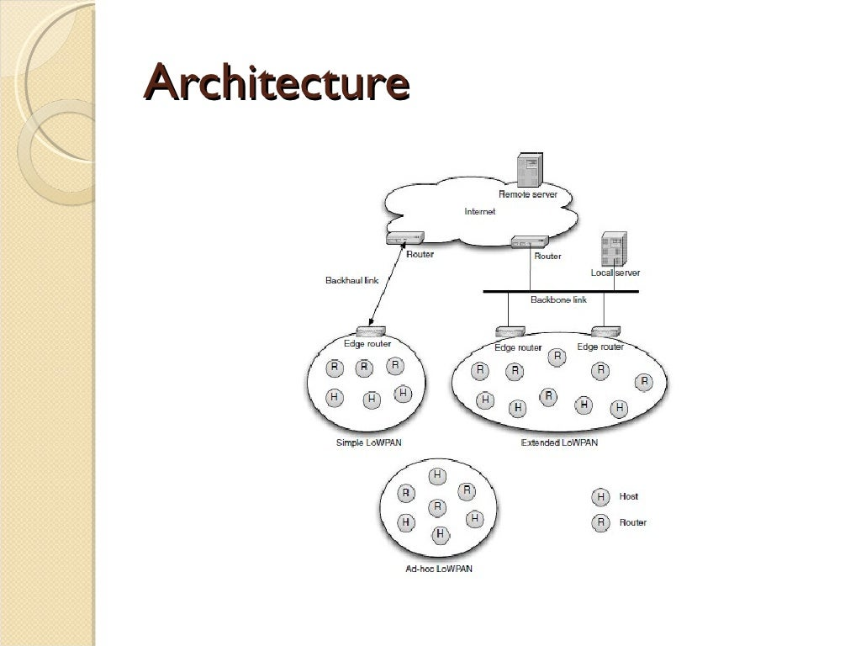

Slide 6
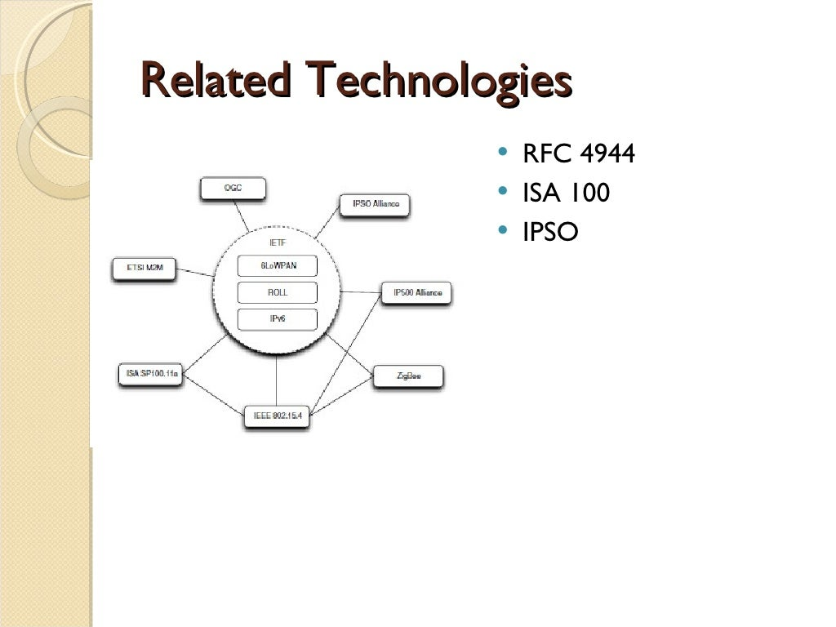
Internet Engineering Task force - IETF
1. Request for Comments - RFC
2. International society of automation – ISA
3. Independent Press Standards Organization - IPSO

Slide 7
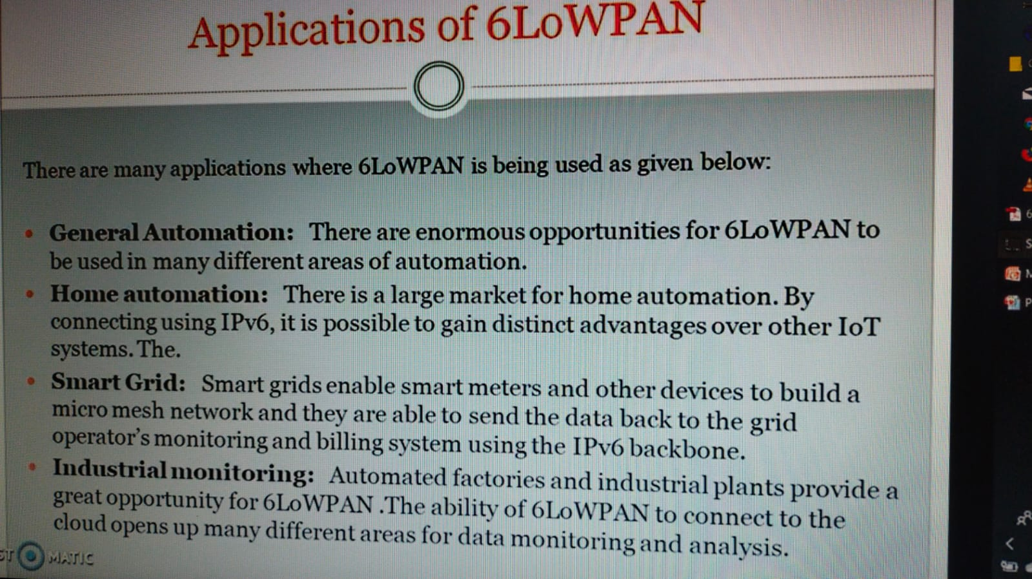

Slide 8
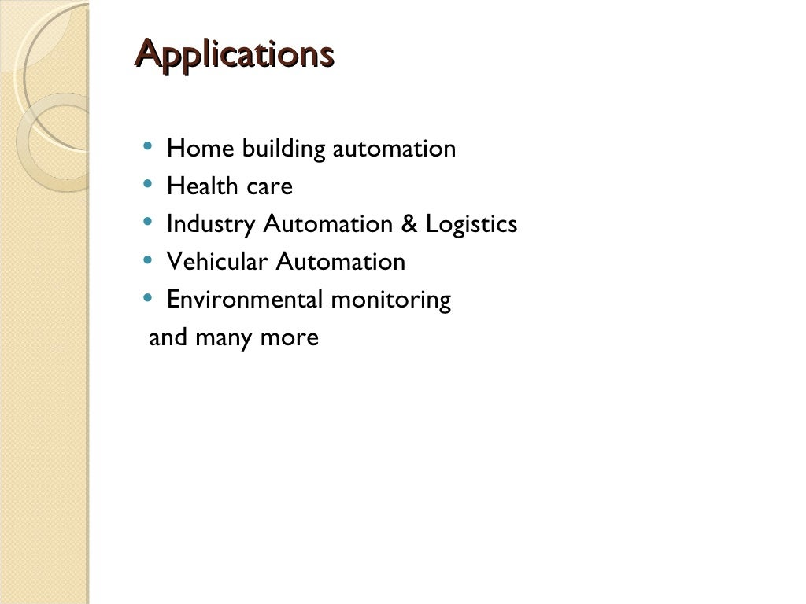

Slide 9
Protocol Stack of 6LoWPAN
Simplified OSI model 6LoWPAN stack
5. Application layer
4. Transport layer
3. Network layer
2. Data link layer
1. Physical layer
HTTP, COAP, MOTT, Websocket, etc.
UDP, TCP (Security TLS/DTLS) TLS-Transport Layer Security DTLS- Datagram TLS
IPv6, RPL
6LoWPAN
IEEE 802.15.4 MAC
IEEE 802.15.4
Note: Adaptation Layer lies between 2 and 3 layers of OSI
(Compression and Decompression header, Fragmentation of data packets etc.)

Slide 10
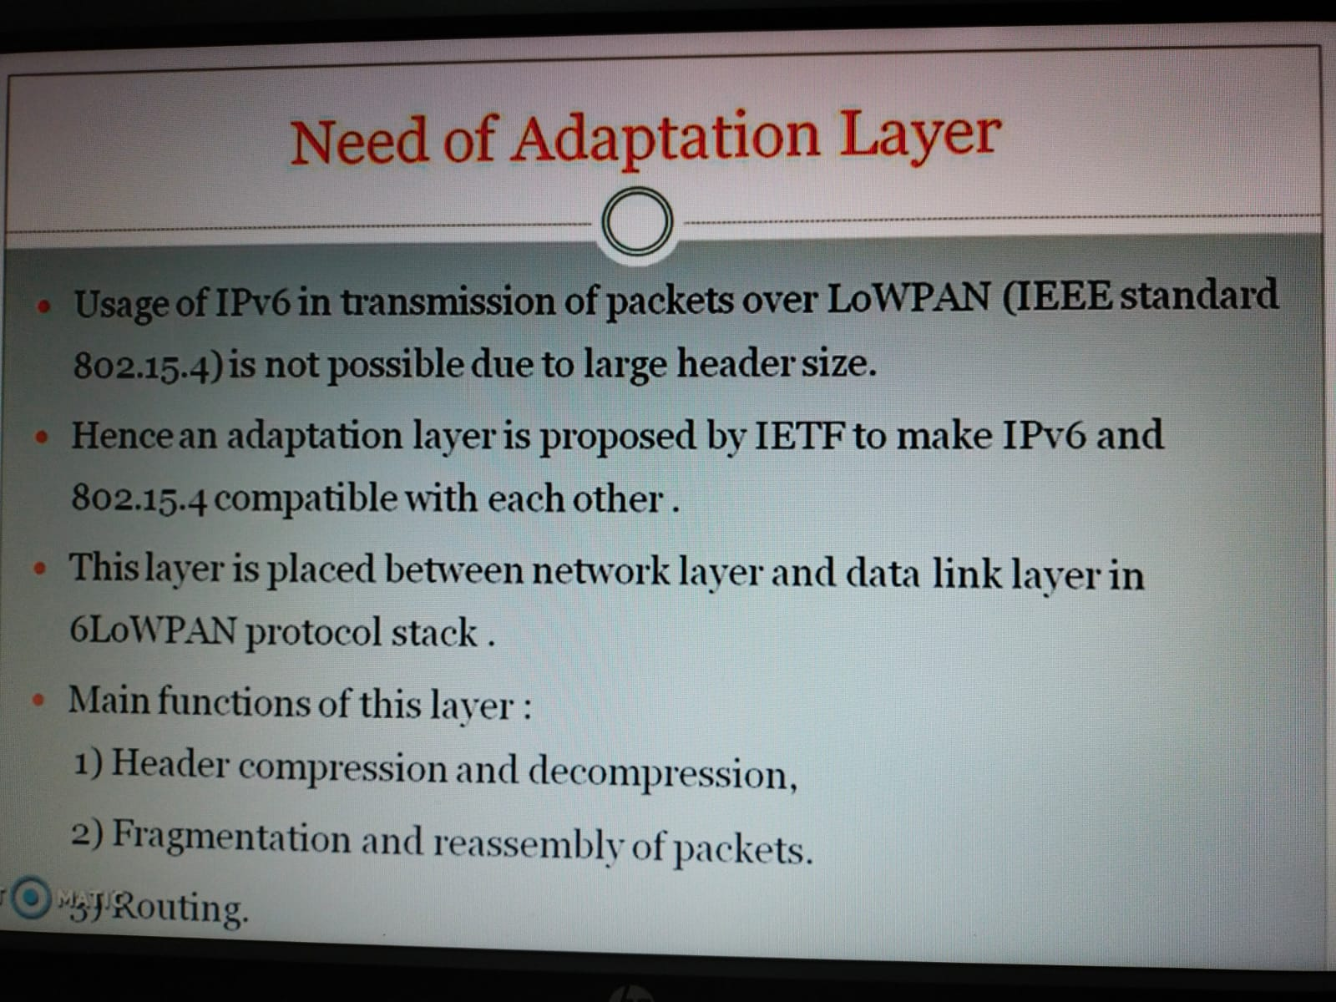

Slide 11
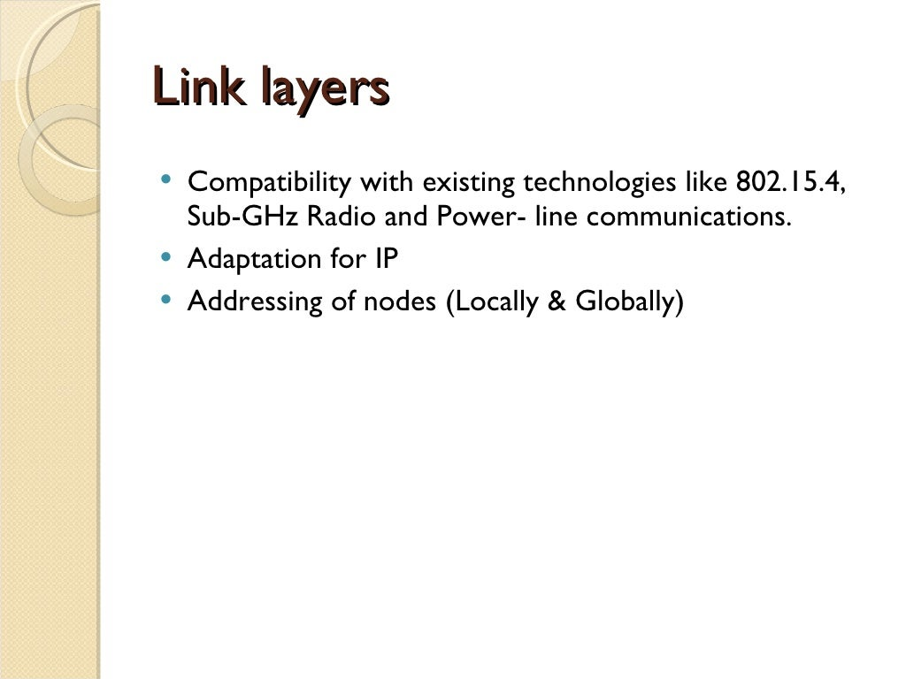

Slide 12
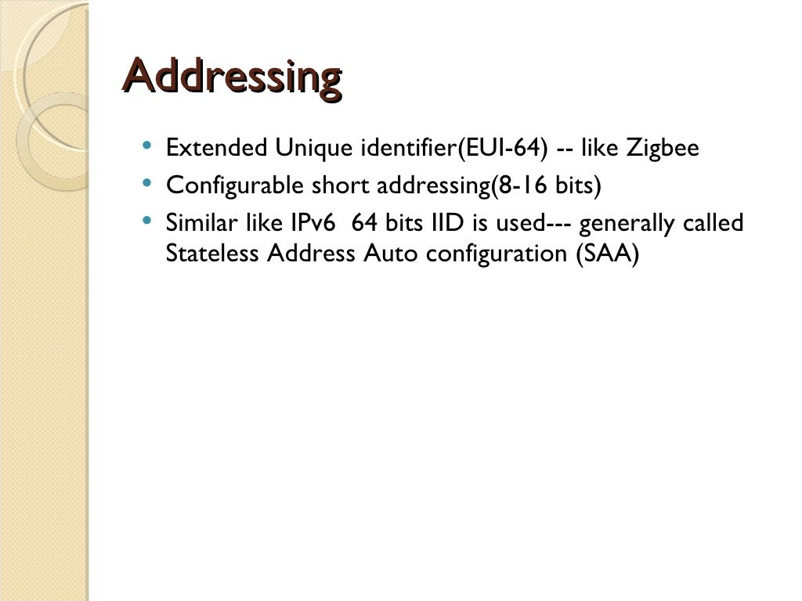

Slide 13
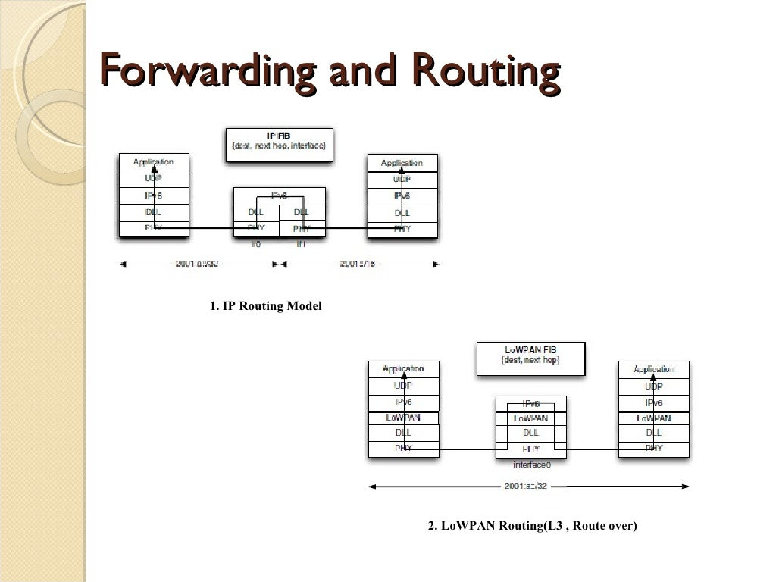

Slide 14
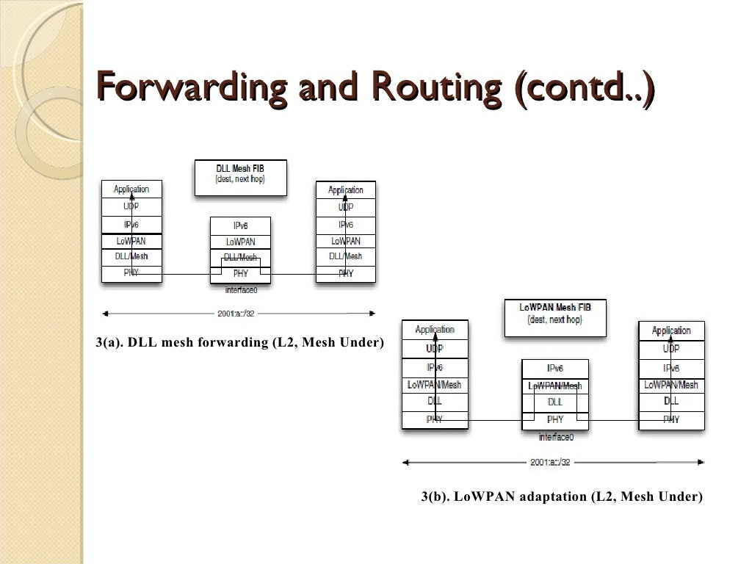

Slide 15
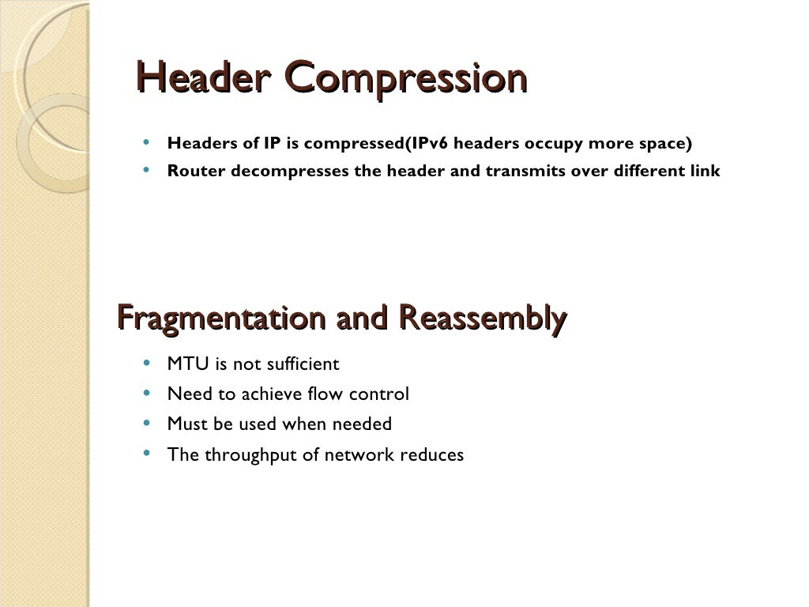

Slide 16
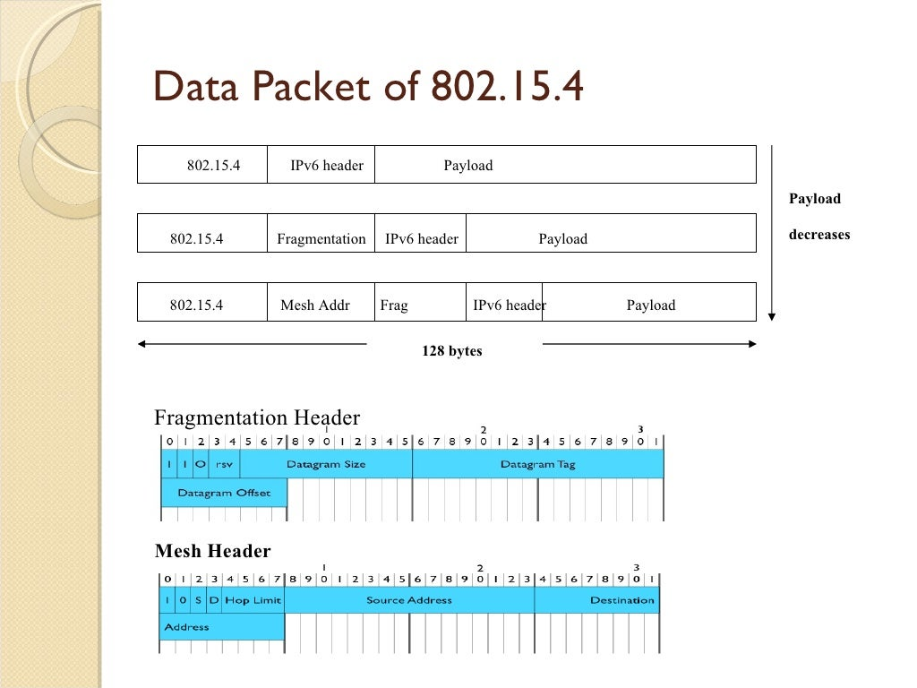

Slide 17
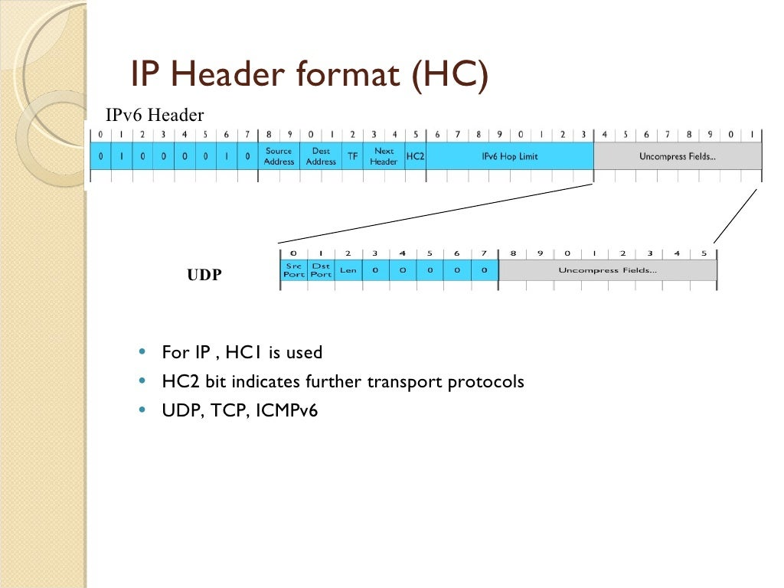

Slide 18
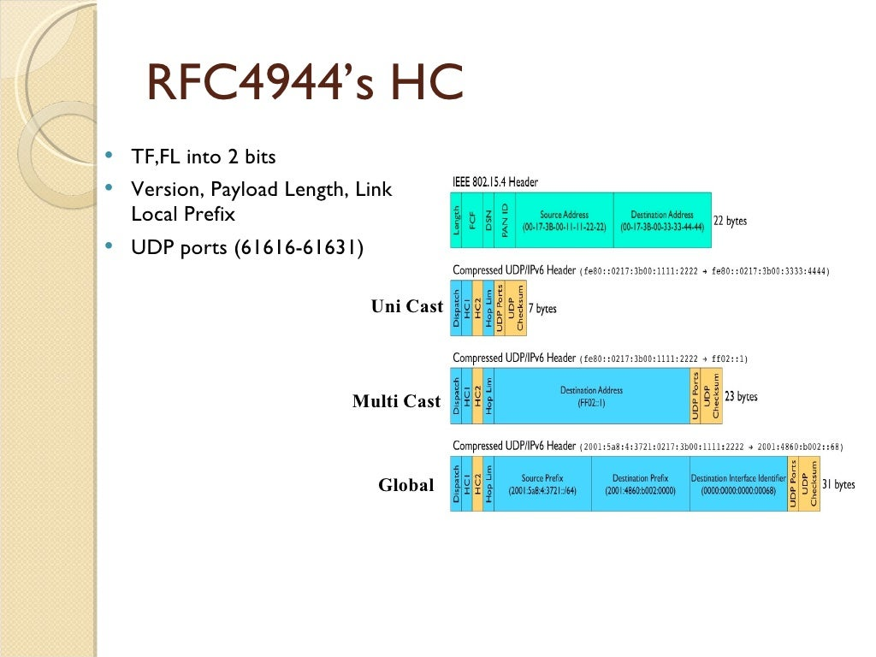

Slide 19
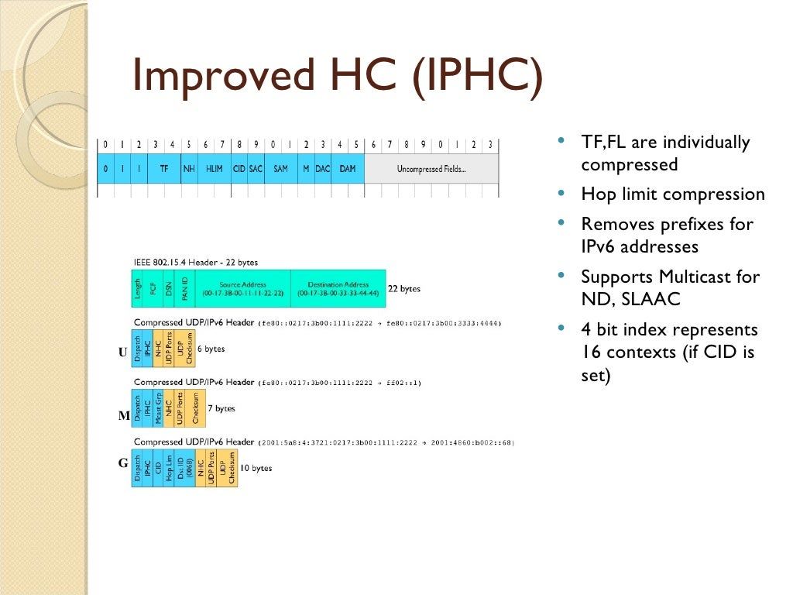

Slide 20
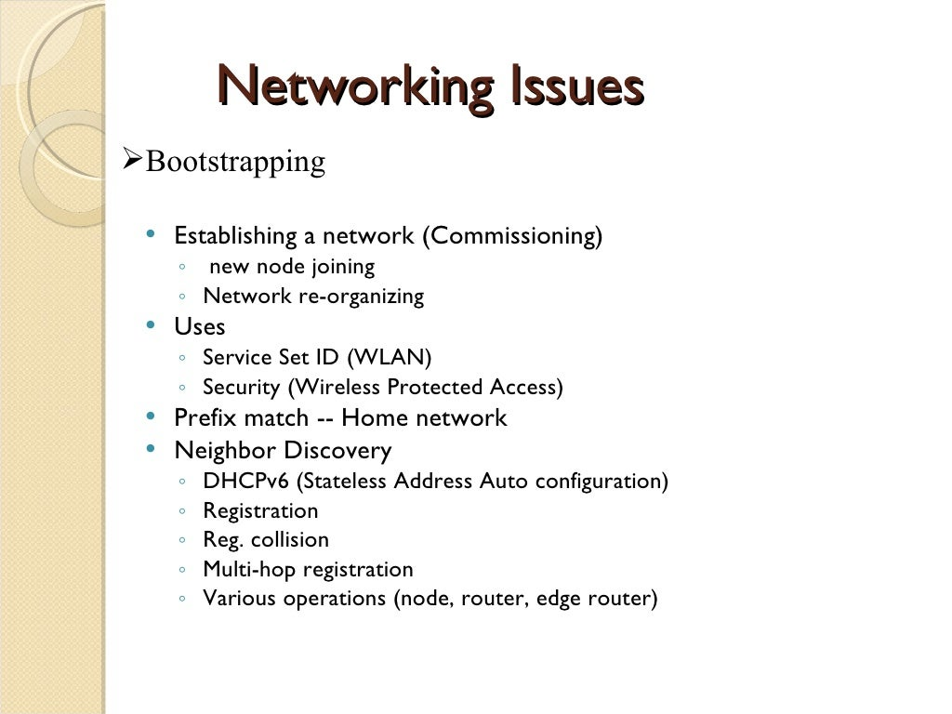
Bootstrapping describes a situation in which an entrepreneur starts a company with little capital, relying on money other than outside investments.

Slide 21
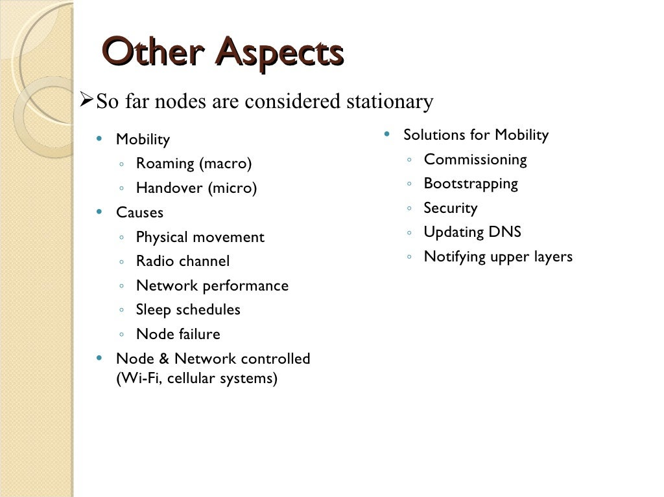

Slide 22
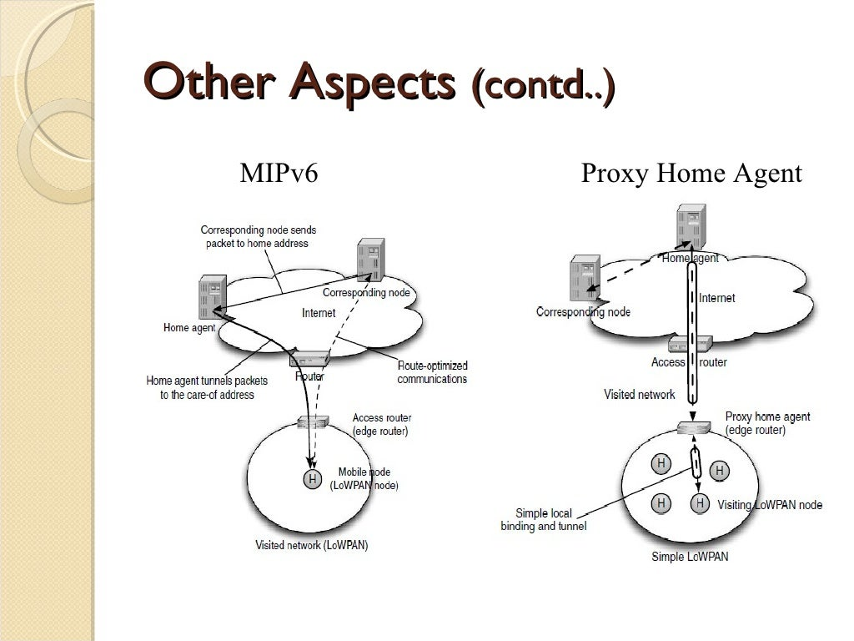

Slide 23
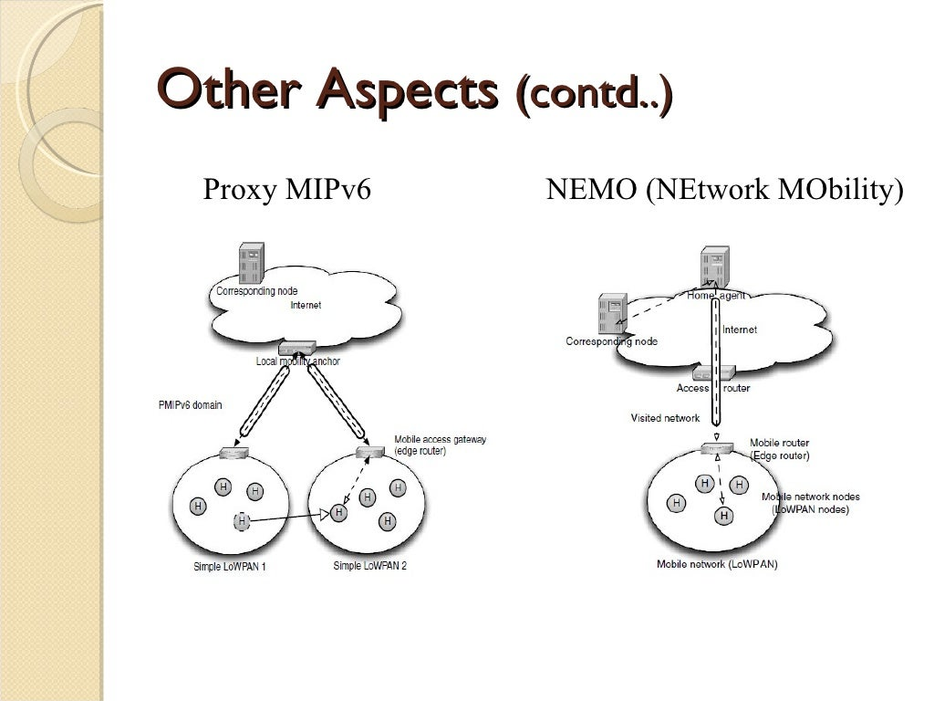

Slide 24
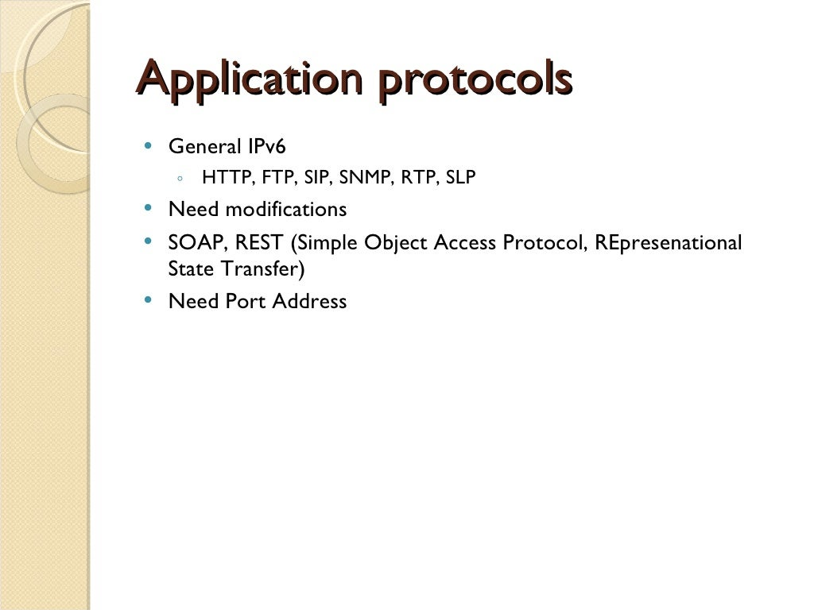

Slide 25
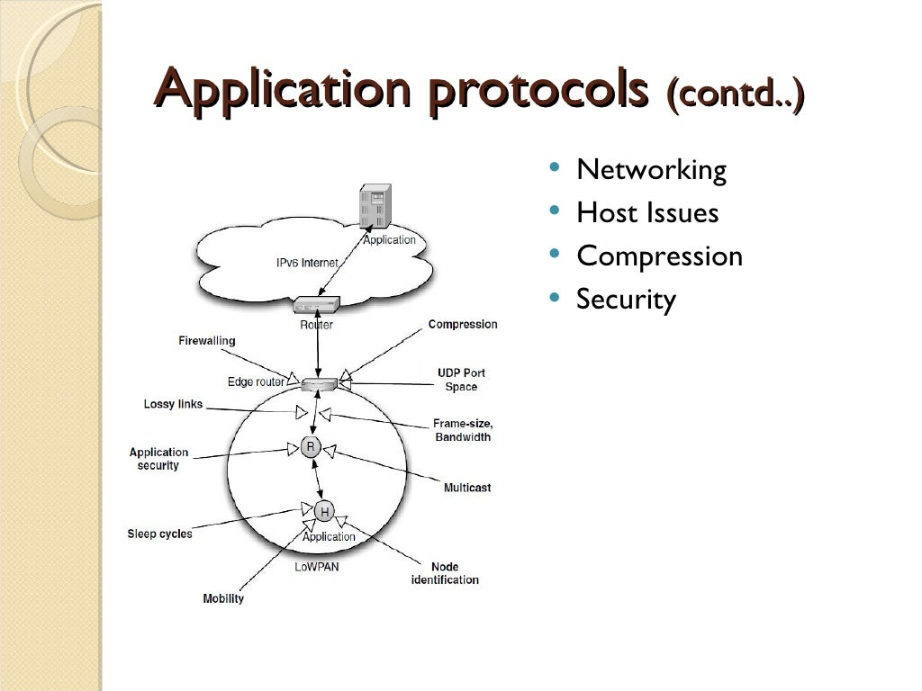

Slide 26
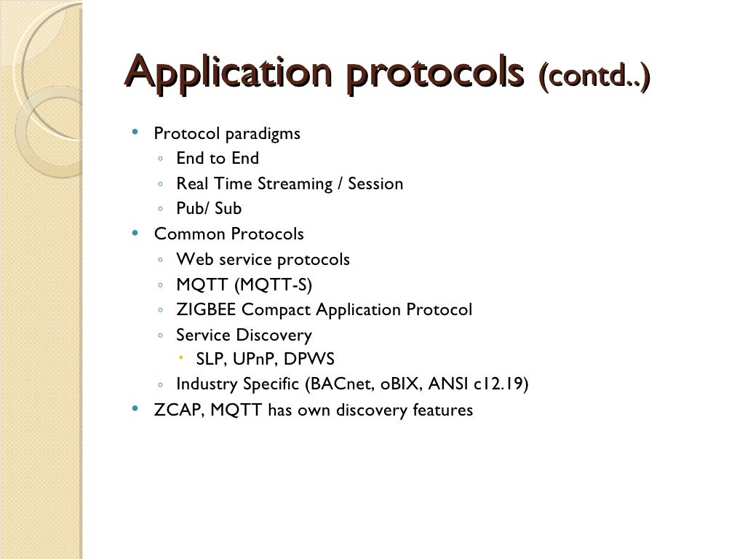

Slide 27
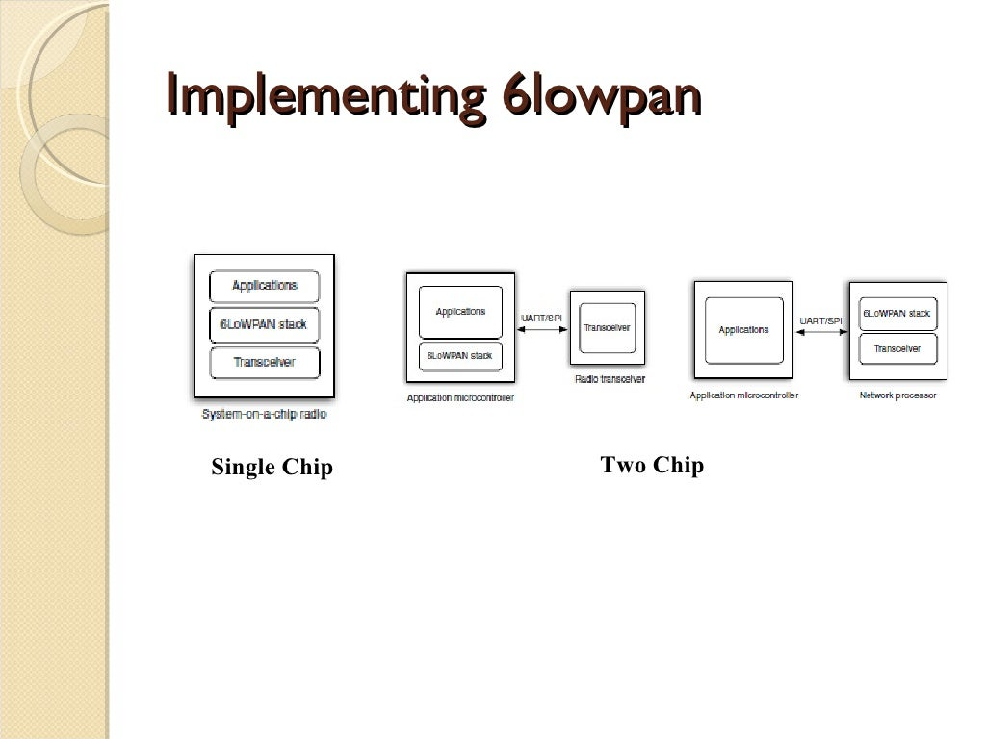

Slide 28
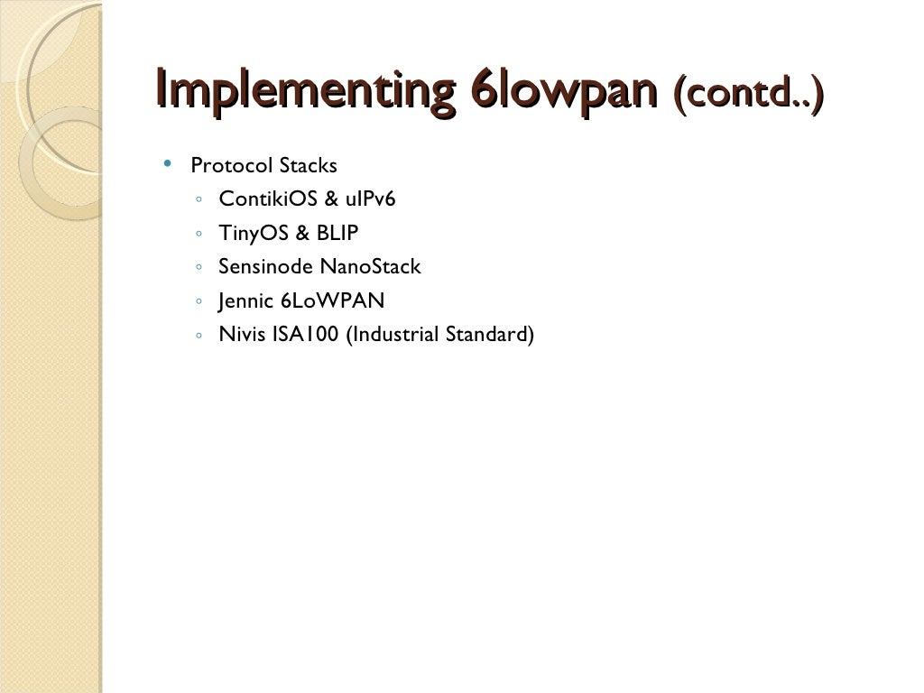

Slide 29
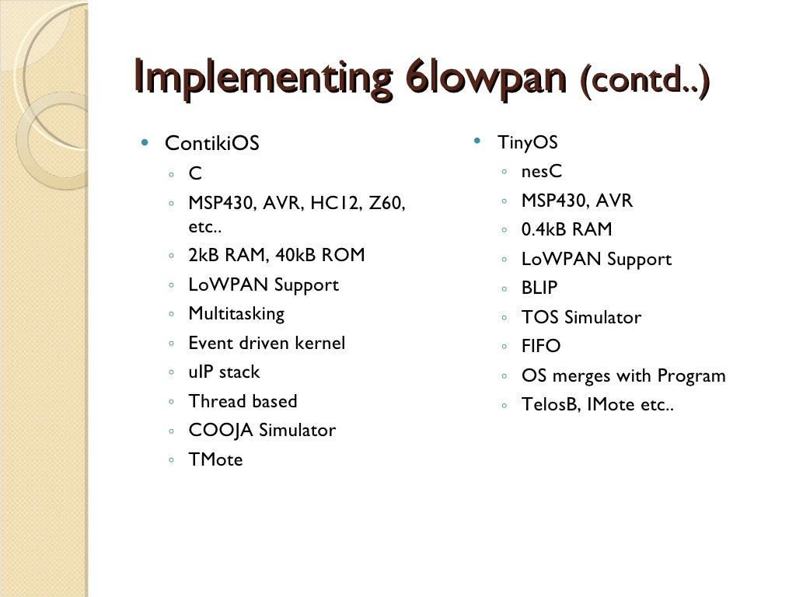

Slide 30
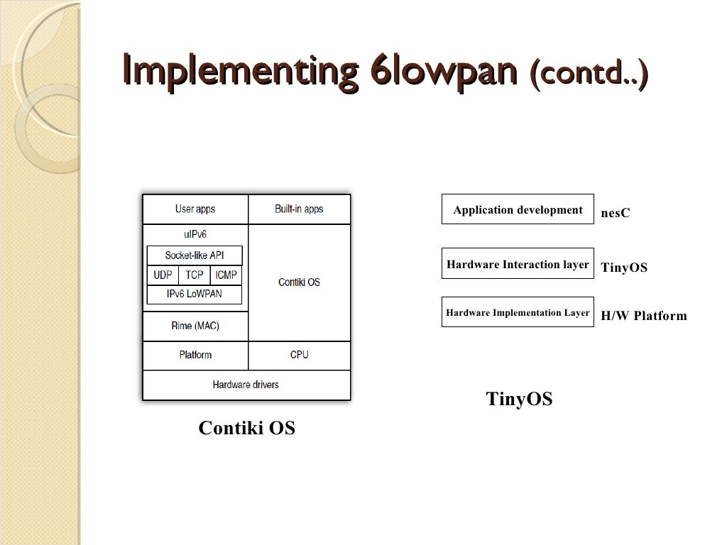

Slide 31

Any Doubts

